Slide 1
Chapter 3
Modeling in the Time Domain

Slide 2
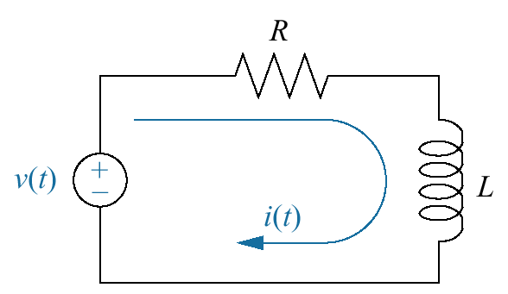
Figure 3.1
RL network

Slide 3
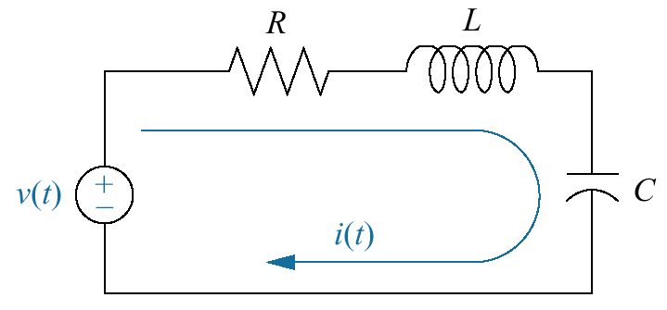
Figure 3.2
RLC network

Slide 4
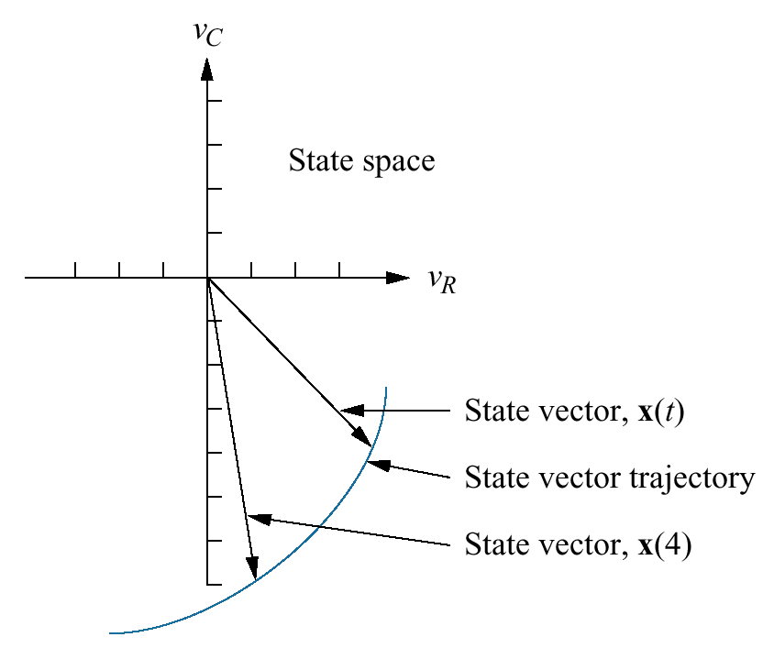
Figure 3.3
Graphic representation
of state space and a
state vector

Slide 5
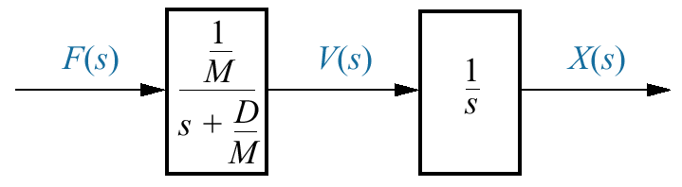
Figure 3.4
Block diagram of a
mass and damper

Slide 6
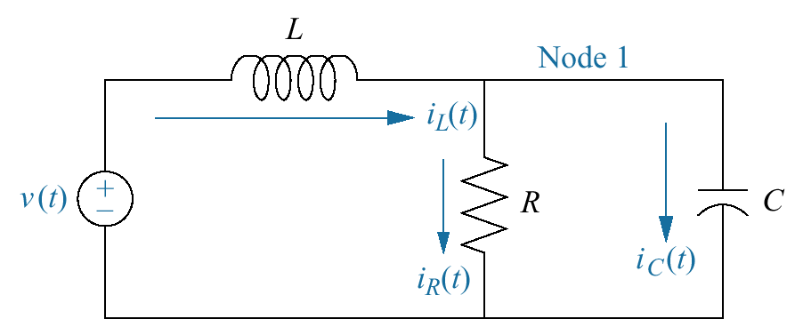
Figure 3.5
Electrical network for
representation in state
space

Slide 7
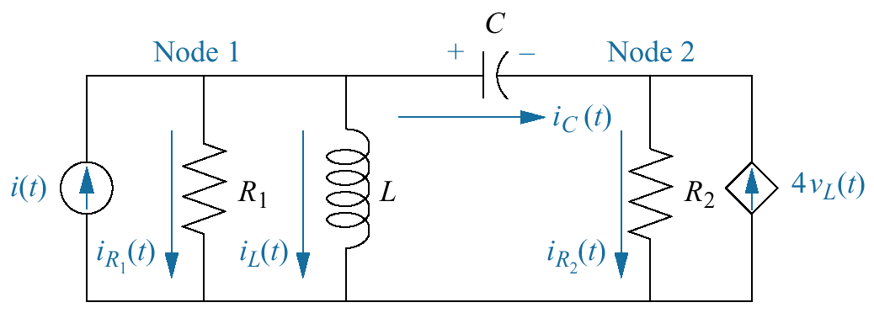
Figure 3.6
Electrical network for
Example 3.2

Slide 8
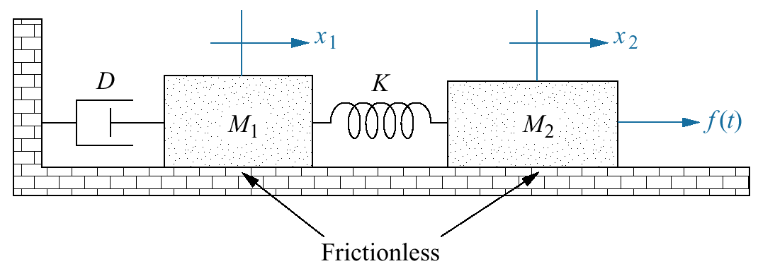
Figure 3.7
Translational
mechanical system

Slide 9
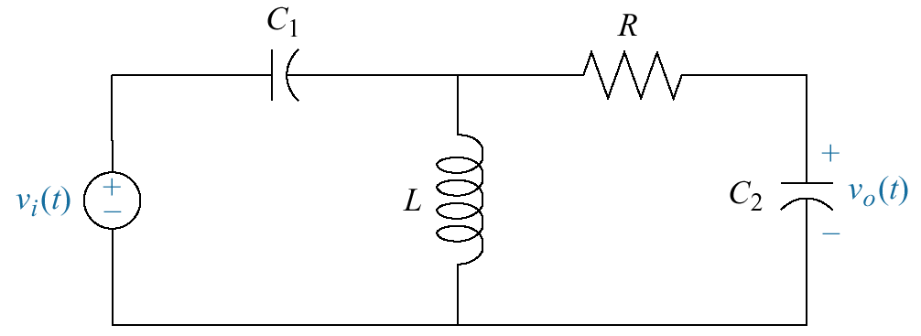
Figure 3.8
Electric circuit
for Skill-Assessment
Exercise 3.1

Slide 10
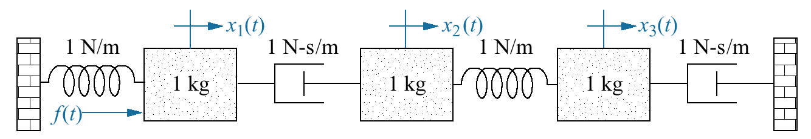
Figure 3.9
Translational
mechanical system
for Skill-Assessment
Exercise 3.2

Slide 11
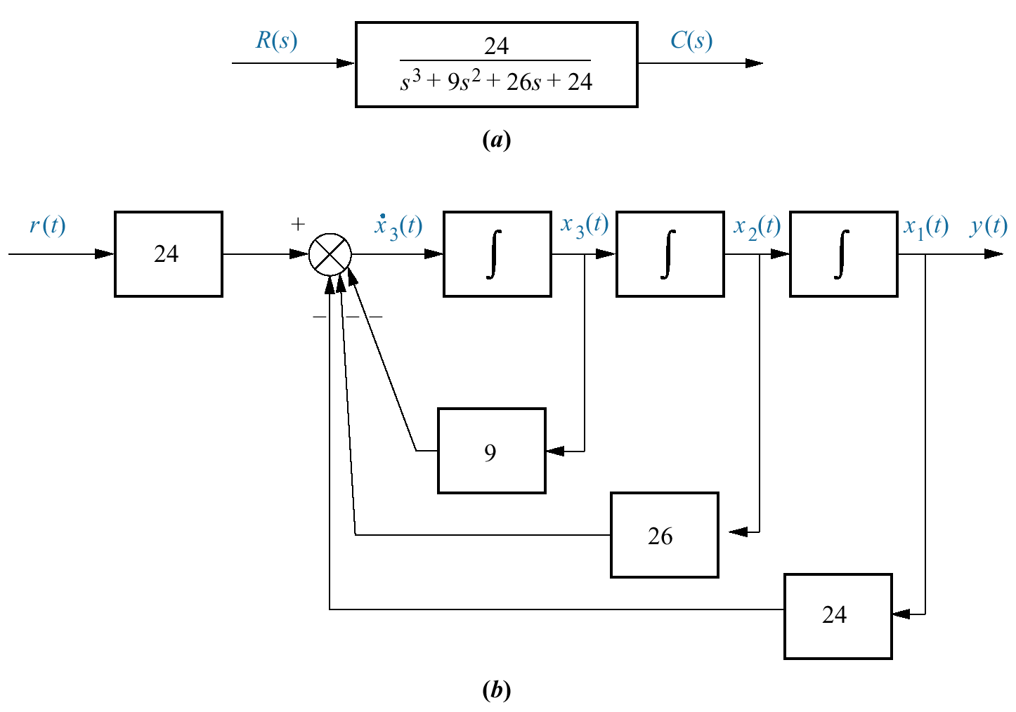
Figure 3.10
a. Transfer function;
b. equivalent block
diagram showing
phase-variables.
Note: y(t) = c(t)

Slide 12
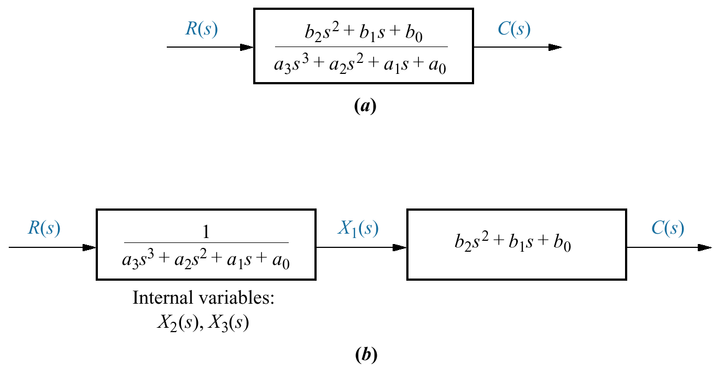
Figure 3.11
Decomposing a
transfer function

Slide 13
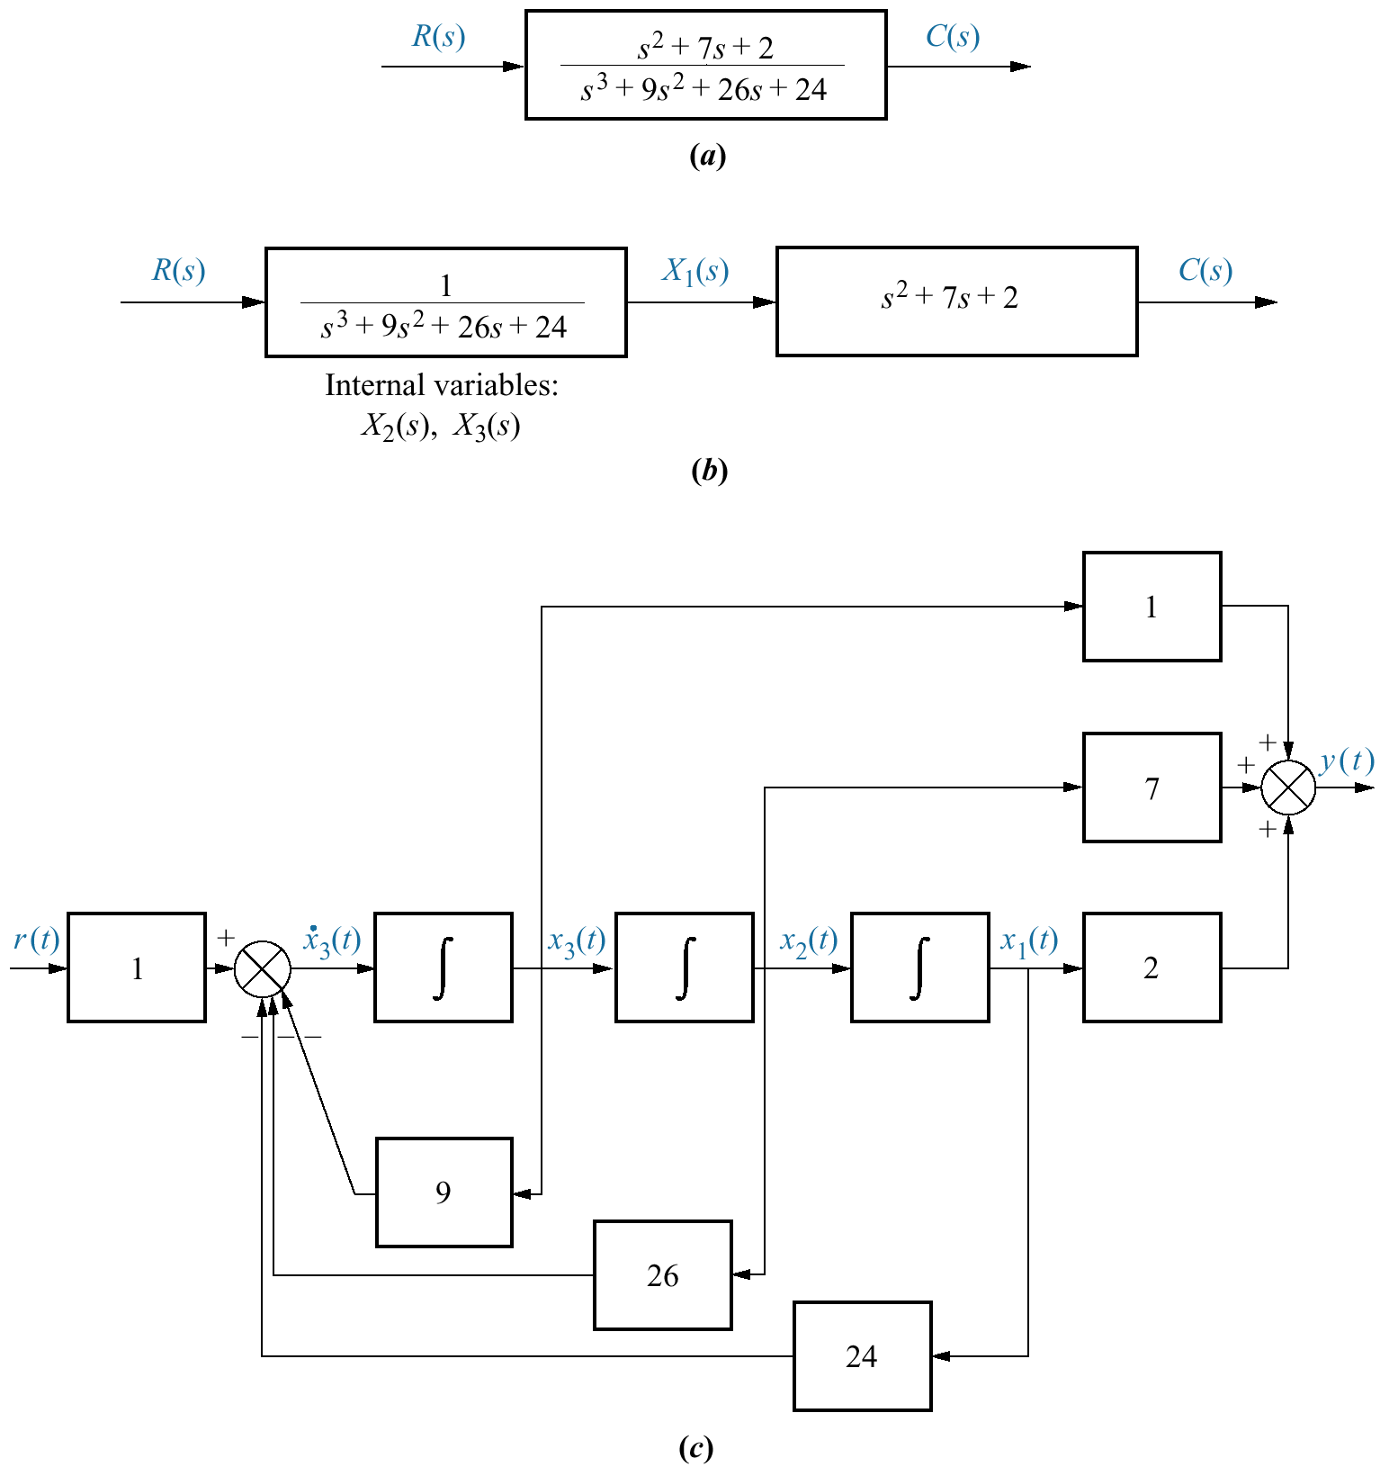
Figure 3.12
a. Transfer function;
b. decomposed
transfer function;
c. equivalent block
diagram. Note:
y(t) = c(t)

Slide 14
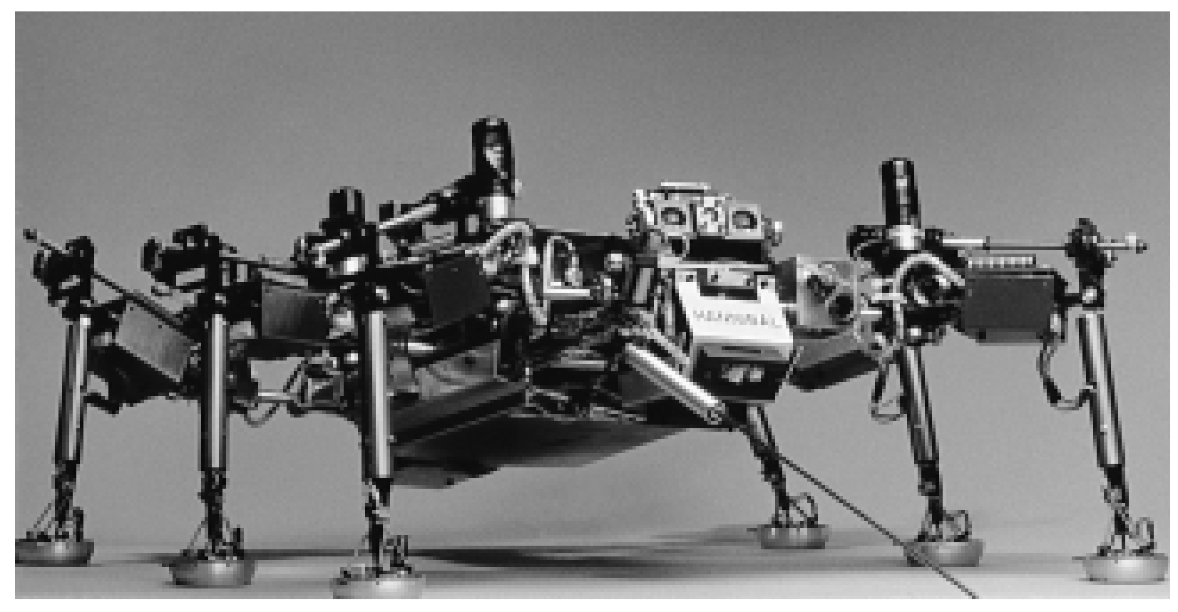
Figure 3.13
Walking robots,
such as Hannibal
shown here, can
be used to explore
hostile
environments and
rough terrain,
such as that found
on other planets
or inside
volcanoes.

Slide 15
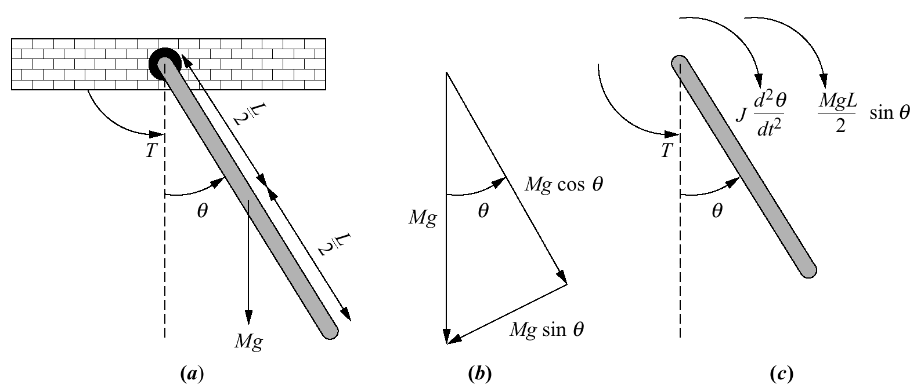
Figure 3.14
a. Simple pendulum;
b. force components
of Mg;
c. free-body diagram

Slide 16
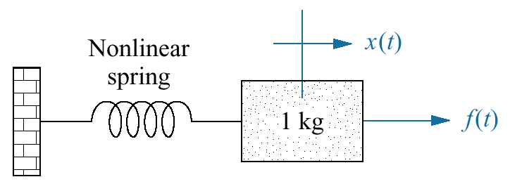
Figure 3.15
Nonlinear translational
mechanical system
for Skill-Assessment
Exercise 3.5

Slide 17
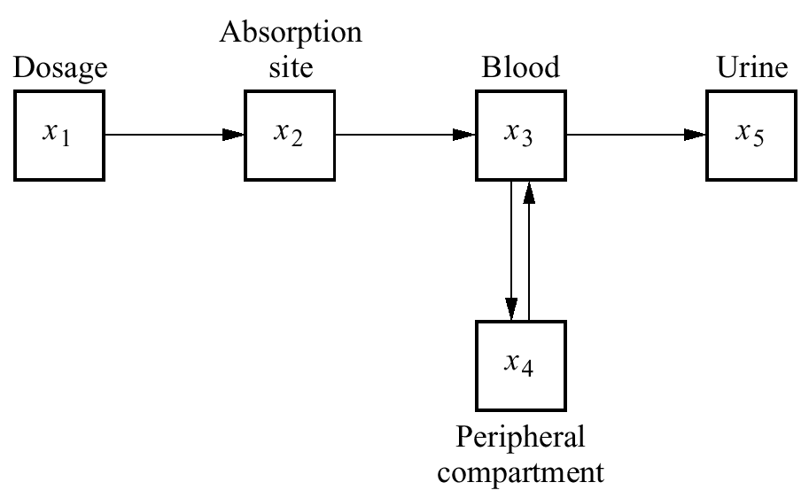
Figure 3.16
Pharmaceutical
drug-level
concentrations
in a human

Slide 18
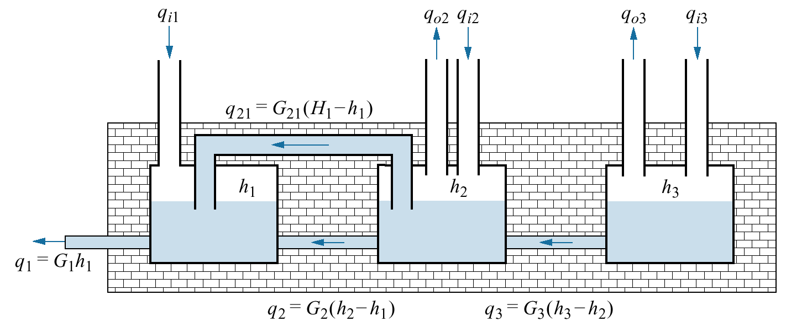
Figure 3.17
Aquifer system model

Slide 19
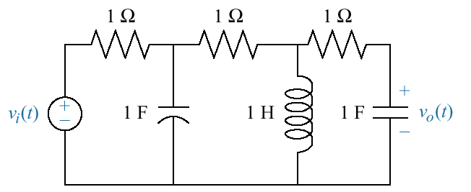
Figure P3.1

Slide 20
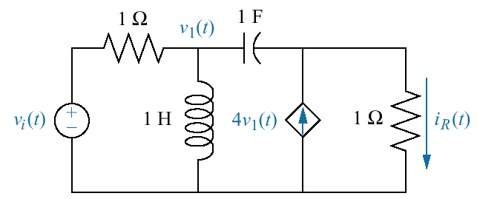
Figure P3.2

Slide 21
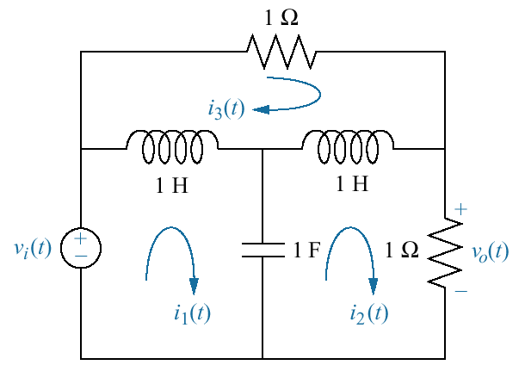
Figure P3.3

Slide 22
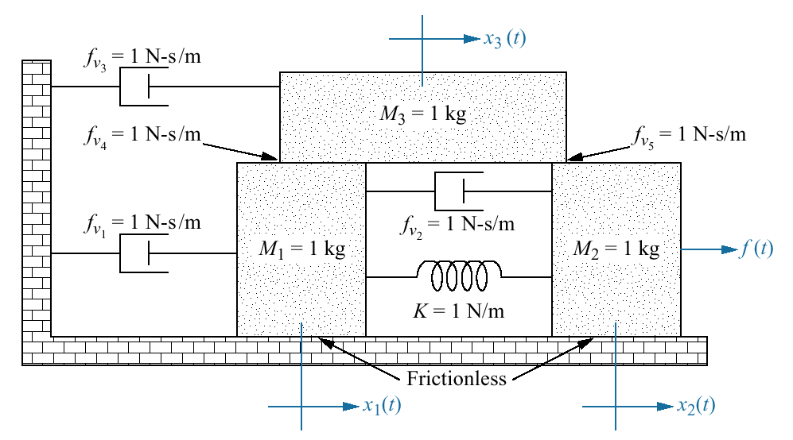
Figure P3.4

Slide 23
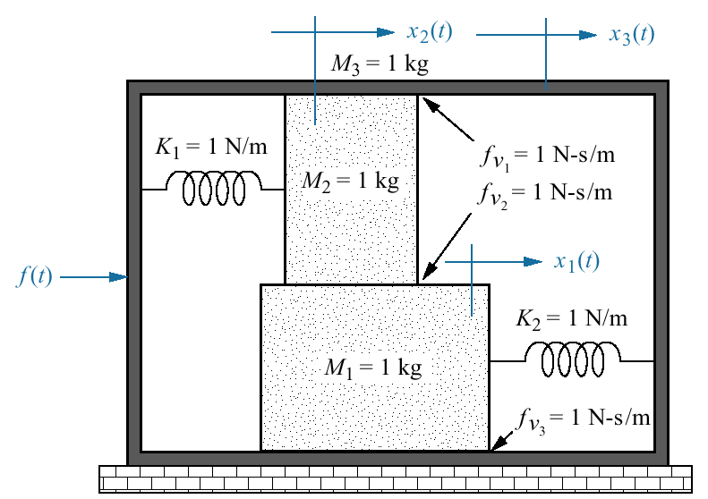
Figure P3.5

Slide 24
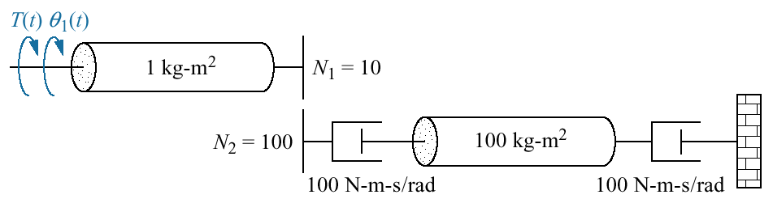
Figure P3.6

Slide 25
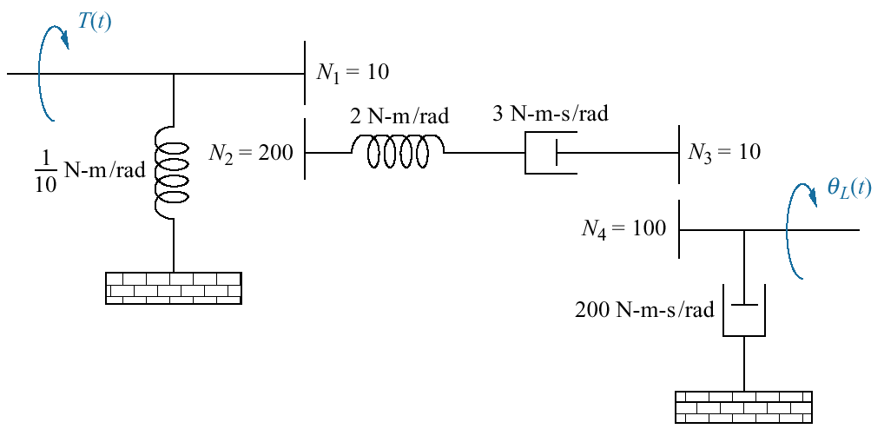
Figure P3.7

Slide 26
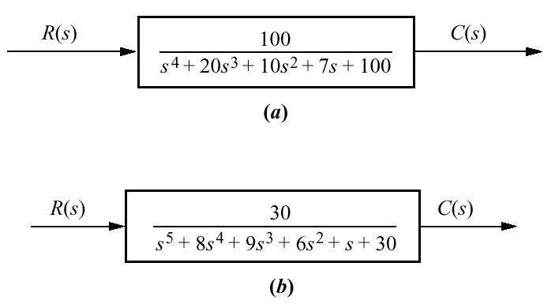
Figure P3.8

Slide 27
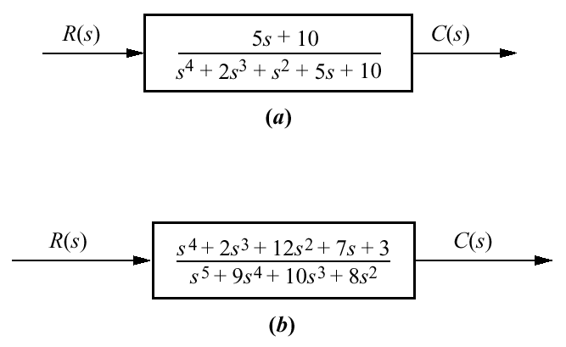
Figure P3.9

Slide 28
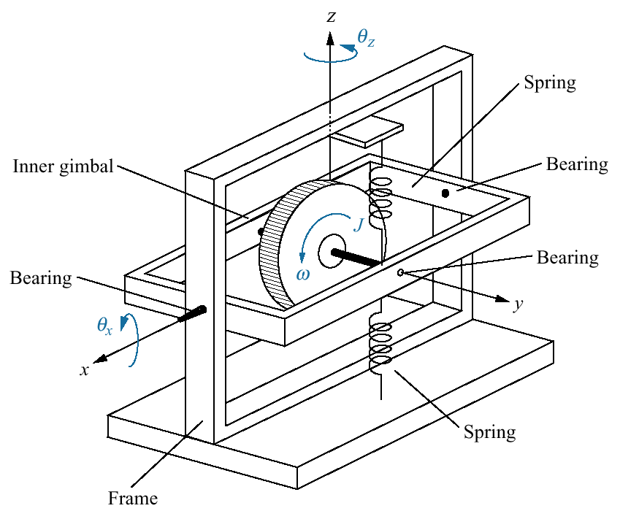
Figure P3.10
Gyro system

Slide 29
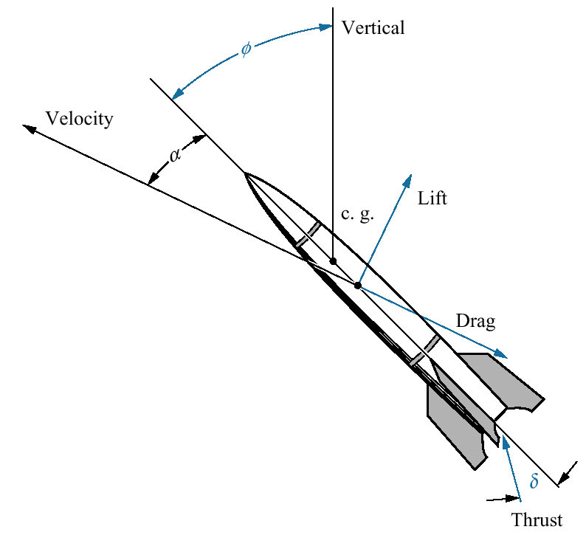
Figure P3.11
Missile

Slide 30
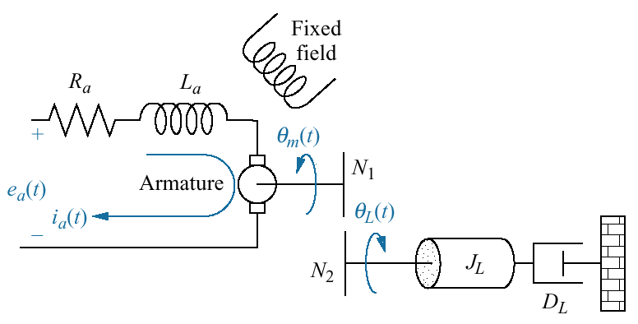
Figure P3.12
Motor and load

Slide 31
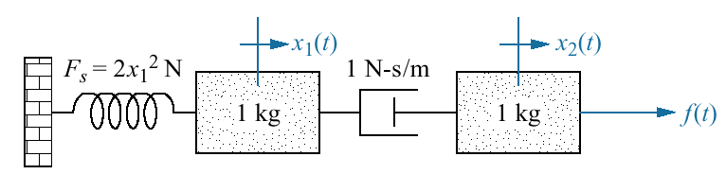
Figure P3.13
Nonlinear mechanical
system

Slide 32
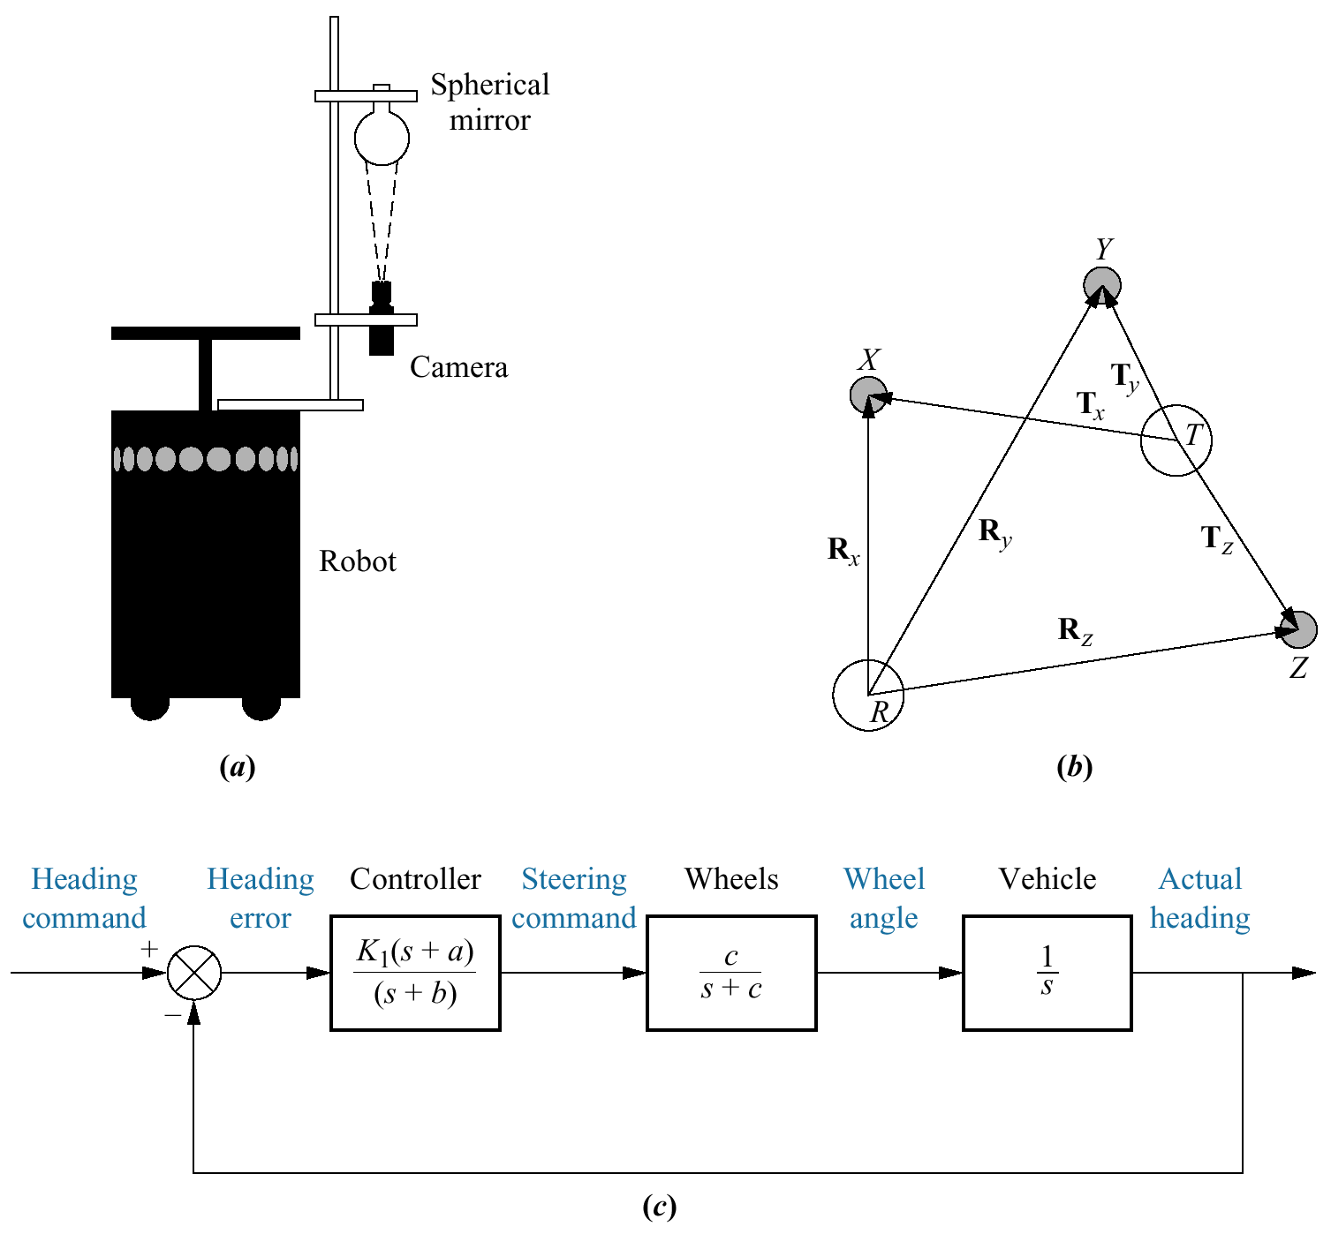
Figure P3.14
a. Robot with
television imaging
system
(©1992 IEEE);
b. vector diagram
showing concept
behind image-based
homing
(©1992 IEEE);
c. heading control
system

Slide 33
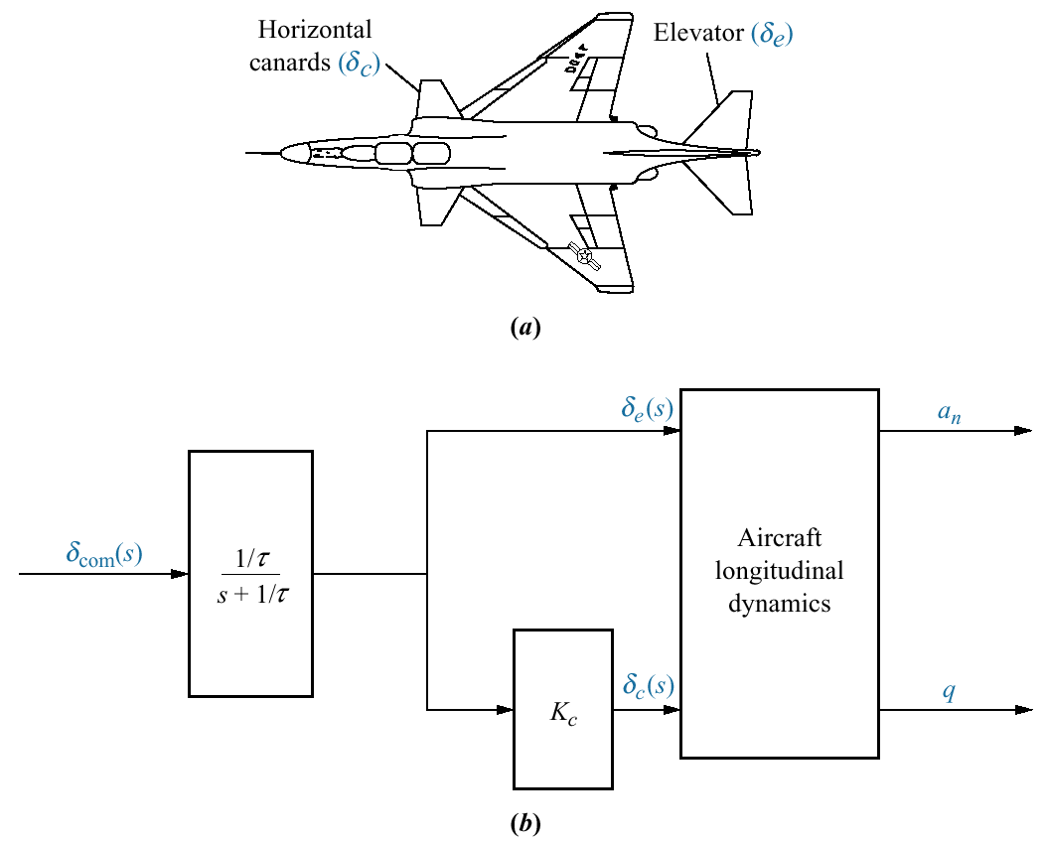
Figure P3.15
a. F4-E with canards
(© 1992 AIAA);
b. open-loop flight
control system
(© 1992 AIAA)

Slide 34
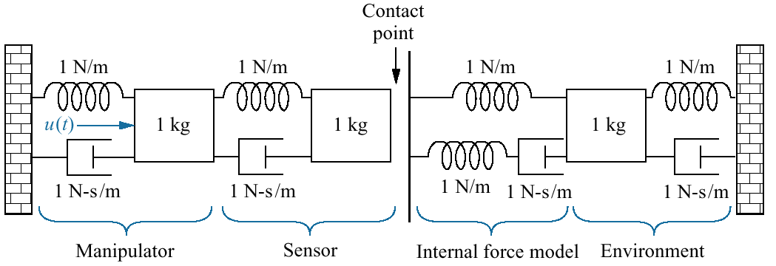
Figure P3.16
Robotic manipulator
and target
environment (©1992 IEEE)

